Slide 1

Ahsanullah University of Science & Technology
Department of Computer Science & Engineering
Course No: CSE 4214
Project Presentation
Network Anomaly Detection
Presented By
Amit Hasan 170104055
Tunazzin Topu 170104066
Almas Shahriar Ador 170104074
Submitted to-
Faisal Muhammad Shah, Associate Professor
Farzad Ahmed, Lecturer
Md. Tanvir Rouf Shawon, Lecturer
Department of CSE, AUST.

Slide 2
Network Anomaly Detection

Slide 3
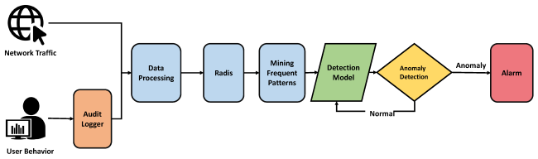
INTRODUCTION
What is Anomaly?
Something that is deviates from what is normal,standard or expected.
Why we need to detect anomaly?
Anomalous data can indicate critical incidents, such as technical glitch, or potential opportunities. Besides it lower the accuracy level or, unrealistically high accuracy levels and over fitting.
Figure 1: Importance of anomaly detection.

Slide 4
MOTIVATION
The issues which are raised while detecting anomalies are low accuracy levels, unrealistically high accuracy levels and over fitting.
Anomaly Detection defend the confidentiality, integrity and other security
The impact of Feature Selection is vital.
Feature Selection Methods refers to important features that improves accuracy.
Enables the Machine Learning algorithm to train faster.

Slide 5
OBJECTIVE
Select the features that contribute the most to network anomaly detection.
Experiments with some features selection algorithms.
Analyze the data using basic machine learning algorithms.

Slide 6
LITERATURE REVIEW
Title | Methodology of selection | Accuracy/Result
K-Nearest Neighbors (KNN) | Used in classification problem, but can be used in regression. Select the number K of the neighbors then calculate the Euclidean distance of k number of neighbors.
Decision Tree (DT) | starts from the root node of the tree. Attribute Selection Measure (ASM). make new decision trees using the subsets that creates recursively.
Network Anomaly Detection and Identification Based on Deep Learning Methods. | Using FNN and CNN Normal, DoS, R2L, U2R and Probe Classification. Experiments with variable hidden layers. | Accuracy using FNN 80.34% Accuracy using CNN 77.8%

Slide 7
LITERATURE REVIEW (cont.)
Title | Methodology of selection | Accuracy/Result
Corr Corr: A feature selection method for multivariate correlation network anomaly detection techniques. | Generates feature correlations and stores them in a matrix. Features are ranked by the strength of correlation. | Achieved the best results with an accuracy of 98.65%.
Feature Selection Method for anomaly detection Based on Improved Genetic Algorithm. | A search strategy to obtain a optimal subset of features . Decision tree is used as a classifier | Achieved 99.66% detection rate and 0.70% false negative rate.
Feature Selection Algorithms in Intrusion Detection System: A Survey. | Intrusion Detection System (IDS) to detect best features. Focusing on SVM, DT, BN, K means clustering ,Immune Artificial System (IAS) and evolutionary algorithm.

Slide 8
Dataset
CSE-CIC-IDS 2018 Dataset:
CSE-CIC-IDS 2018 dataset by the University of New Brunswick for analyzing DDoS data.
Attacks such as DoS, DDos, Brute force, XSS, SQL injection, Infiltration and Botnet.
Completely labelled and about 81 network traffic features.

Slide 9
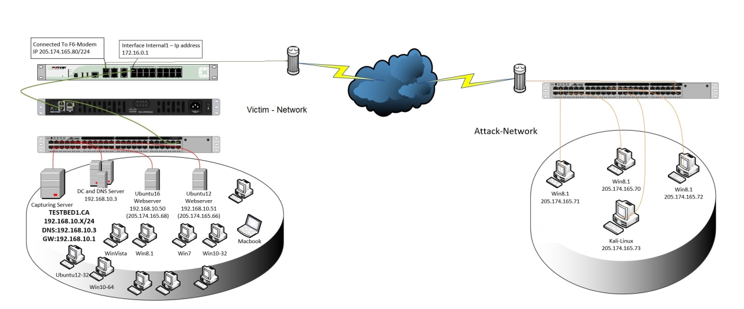
Dataset (Cont.)
Figure 2: Formation of dataset.

Slide 10
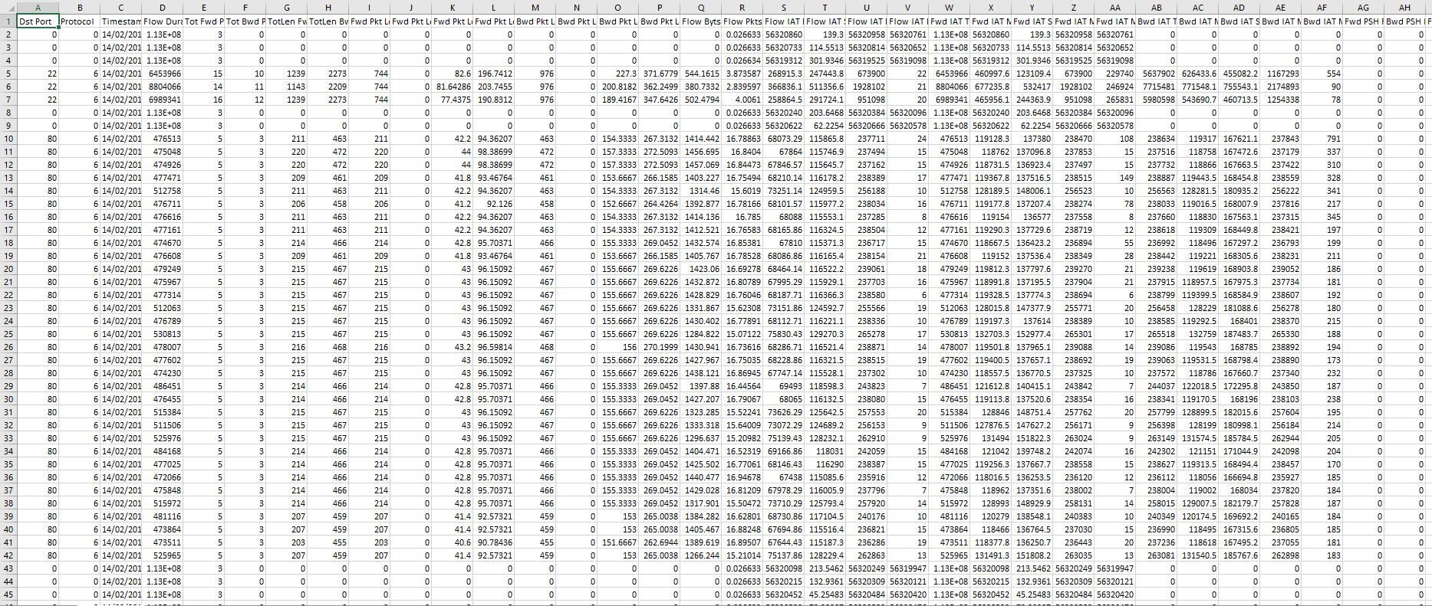
Dataset (Cont.)

Slide 11
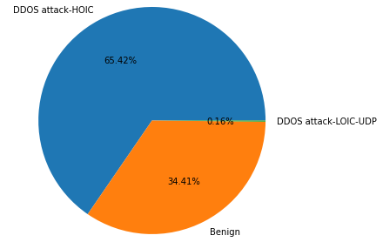
Dataset (Cont.)
The implemented attacks include Brute Force FTP, Brute Force SSH and Benign are executed
The result are given in the pie chart.
Figure 3:The malicious attack which represent in Pie Chart

Slide 12
Dataset (Cont.)
Imbalanced dataset
Severely skewed class distribution.
Poor performance with traditional
machine learning models .
Poor performance of evaluation metrics that assume a balanced class distribution.
Figure: Pie chart of Imbalanced Dataset

Slide 13
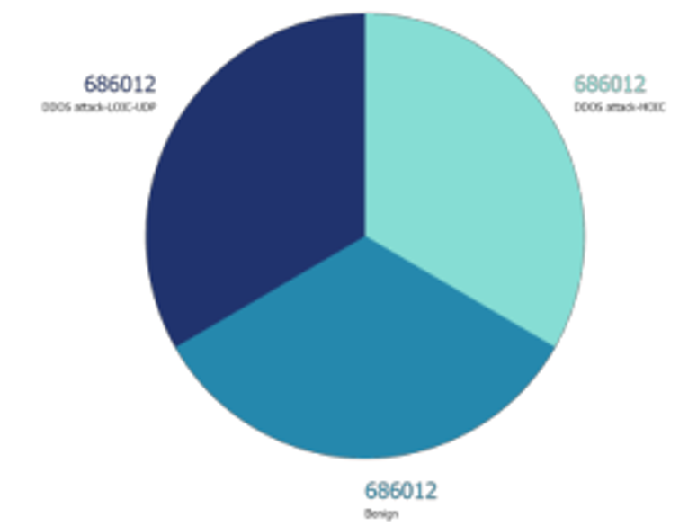

Dataset (Cont.)
❖ Balancing the Dataset:
Among all the techniques of balancing dataset we are using ,
➢ Synthetic Minority Oversampling Technique or SMOTE for short.
➢ This is a sort of data augmentation that works well with tabular data.
➢ We simply duplicate minority class samples in the training dataset before fitting a model.
Figure: Balanced Dataset
Figure: Balancing Dataset

Slide 14
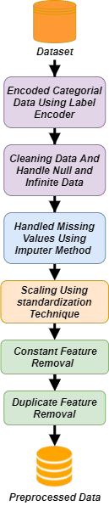
Dataset Preprocessing
Encoding categorical data using Label Encoder.
Cleaning the dataset.
Handling missing values using Imputer
method.
Feature scaling using Standardization
technique.
Constant and duplicate features removal.
Fig: Dataset Preprocessing

Slide 15
METHODOLOGY
To detect anomaly in the network flow we have mainly approached in the following ways:
Keeping only the important features that will help most
SelectKBest feature selection algorithm to get the score of the features.
Taking top 20 features after applying SelectKBest feature selection algorithm
Using basic Machine Learning algorithms (KNN, DT).

Slide 16
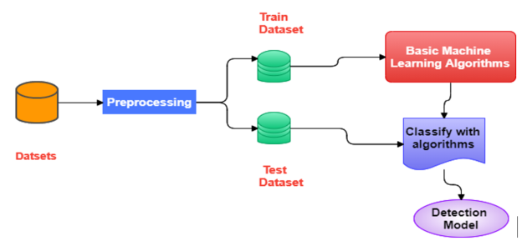
METHODOLOGY (cont.)
Machine Learning Model
Using Decision Tree, KNN and K fold Cross-Validation to detect anomaly in the network flow.
Figure 4: Project Methodology

Slide 17
Experiments and Results
Accuracy and F1-score comparison between two algorithms.
Algorithms | Accuracy (.2f) | F1_score (.2f)
K- Nearest Neighbors Classifier | 0.96 | 0.97
Decision Tree Classifier | 0.96 | 0.97
Table 1: Comparison table

Slide 18
FUTURE WORK
In the future, we will try to implement our own Feature Selection algorithm which will,
Reduce more features.
Select features more precisely.
Train dataset with hybrid models.
Train Machine Learning model well.

Slide 19
CONCLUSION
Anomaly detection is an important problem that has been researched within diverse research areas and application domains.
Several promising directions for further research in anomaly detection.
Contextual and collective anomaly detection techniques are to find increasing applicability.
Will be help full in our networking and communication greatly.

Slide 20
References
[1] Tharam Dillon Florian Gottwalt, Elizabeth Chang. Corr Corr: A feature selection method for multivariate correlation network anomaly detection techniques. University of New South Wales, Canberra, Australia . La Trobe University, Melbourne, Australia, 2019.
[2] Rongpeng Li Jiaqi Li, Zhifeng Zhao. A Machine Learning Based Intrusion Detection System for Software Defined 5G. The Institution of Engineering and Technology, 2015.
[3] DONG JIANG TONGQUAN WEI (Senior Member IEEE) JIEWEN MAO, YONGQUAN HU and FUKE
SHEN. CBFS: A Clustering-Based Feature Selection Mechanism for Network Anomaly Detection. 2020.
[4] ÁNGEREZ2 LORENZO FERNÁNDEZ MAIMÓ 1 and IEEE) GREGORIO MARTÍNEZ PÉREZ2, (Member). A Self-Adaptive Deep Learning-Based System for Anomaly Detection in 5G Networks. Departamento de Ingeniería y Tecnología de Computadores, University of Murcia, 30100 Murcia, Spain. Departamento de Ingeniería de la Información y las Comunicaciones, University of Murcia, 30100 Murcia, Spain, 2018.
[5] Kejiang Ye Mingyi Zhu and Cheng-Zhong Xu. Network Anomaly Detection and Identification Based on Deep Learning Methods. Shenzhen Institutes of Advanced Technology, Chinese Academy of Sciences, Shenzhen, China, 2018.
[6] Zulaiha Ali Othman Osama Alomari. Bees Algorithm for feature selection in Network Anomaly detection. School of Computer Science, Faculty of Information Science and Technology, Universiti Kebangsaan
Malaysia, 43200 Bangi, Selangor, Malaysia Center of Artificial Intelligent, 2012.

Slide 21
Thank You

